Slide 1
Advanced Encryption Standard
By: Jason Molina, Sean Abi Saab, Nicholas Heckers

Slide 2
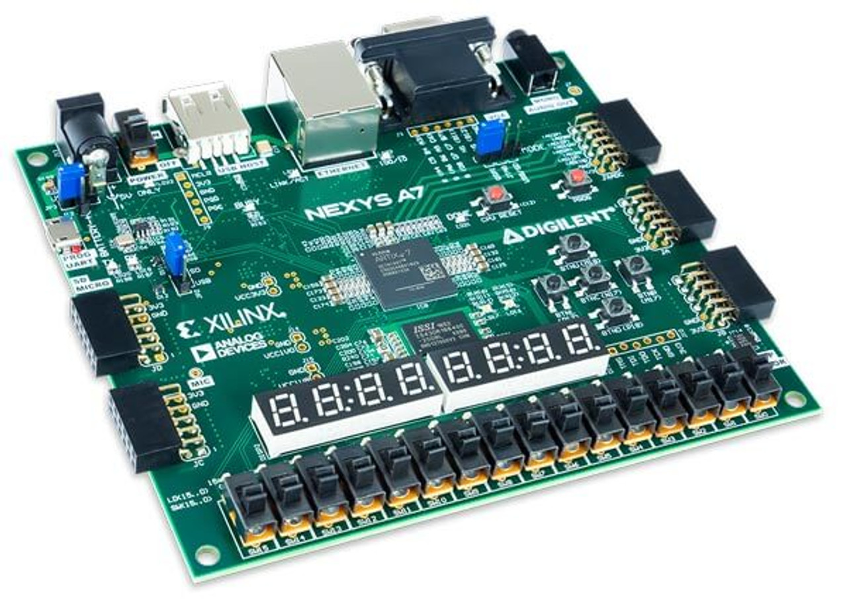
Implementing AES-128 on an FPGA Board
Design Approach:
- Utilized HDL modules to replicate AES standard functions.
- Employed Verilog wires for state transmission, avoiding memory storage.
- Implemented key AES functions: SubBytes, ShiftRows, MixColumns, AddRoundKey.
- Developed a key expansion module following the AES standard's pseudocode.
- Utilized a barrel shifter for ShiftRows and InvShiftRows functions.
- Integrated a PWM controlled RGB LED to indicate encryption state.
- Implemented a data register for storing and updating data to be worked on.
- Enabled data and key display on seven-segment displays with scrolling feature.
- Possible future enhancements: support for longer keys, multiple data blocks processing, and efficient data/key transmission methods.

Slide 3
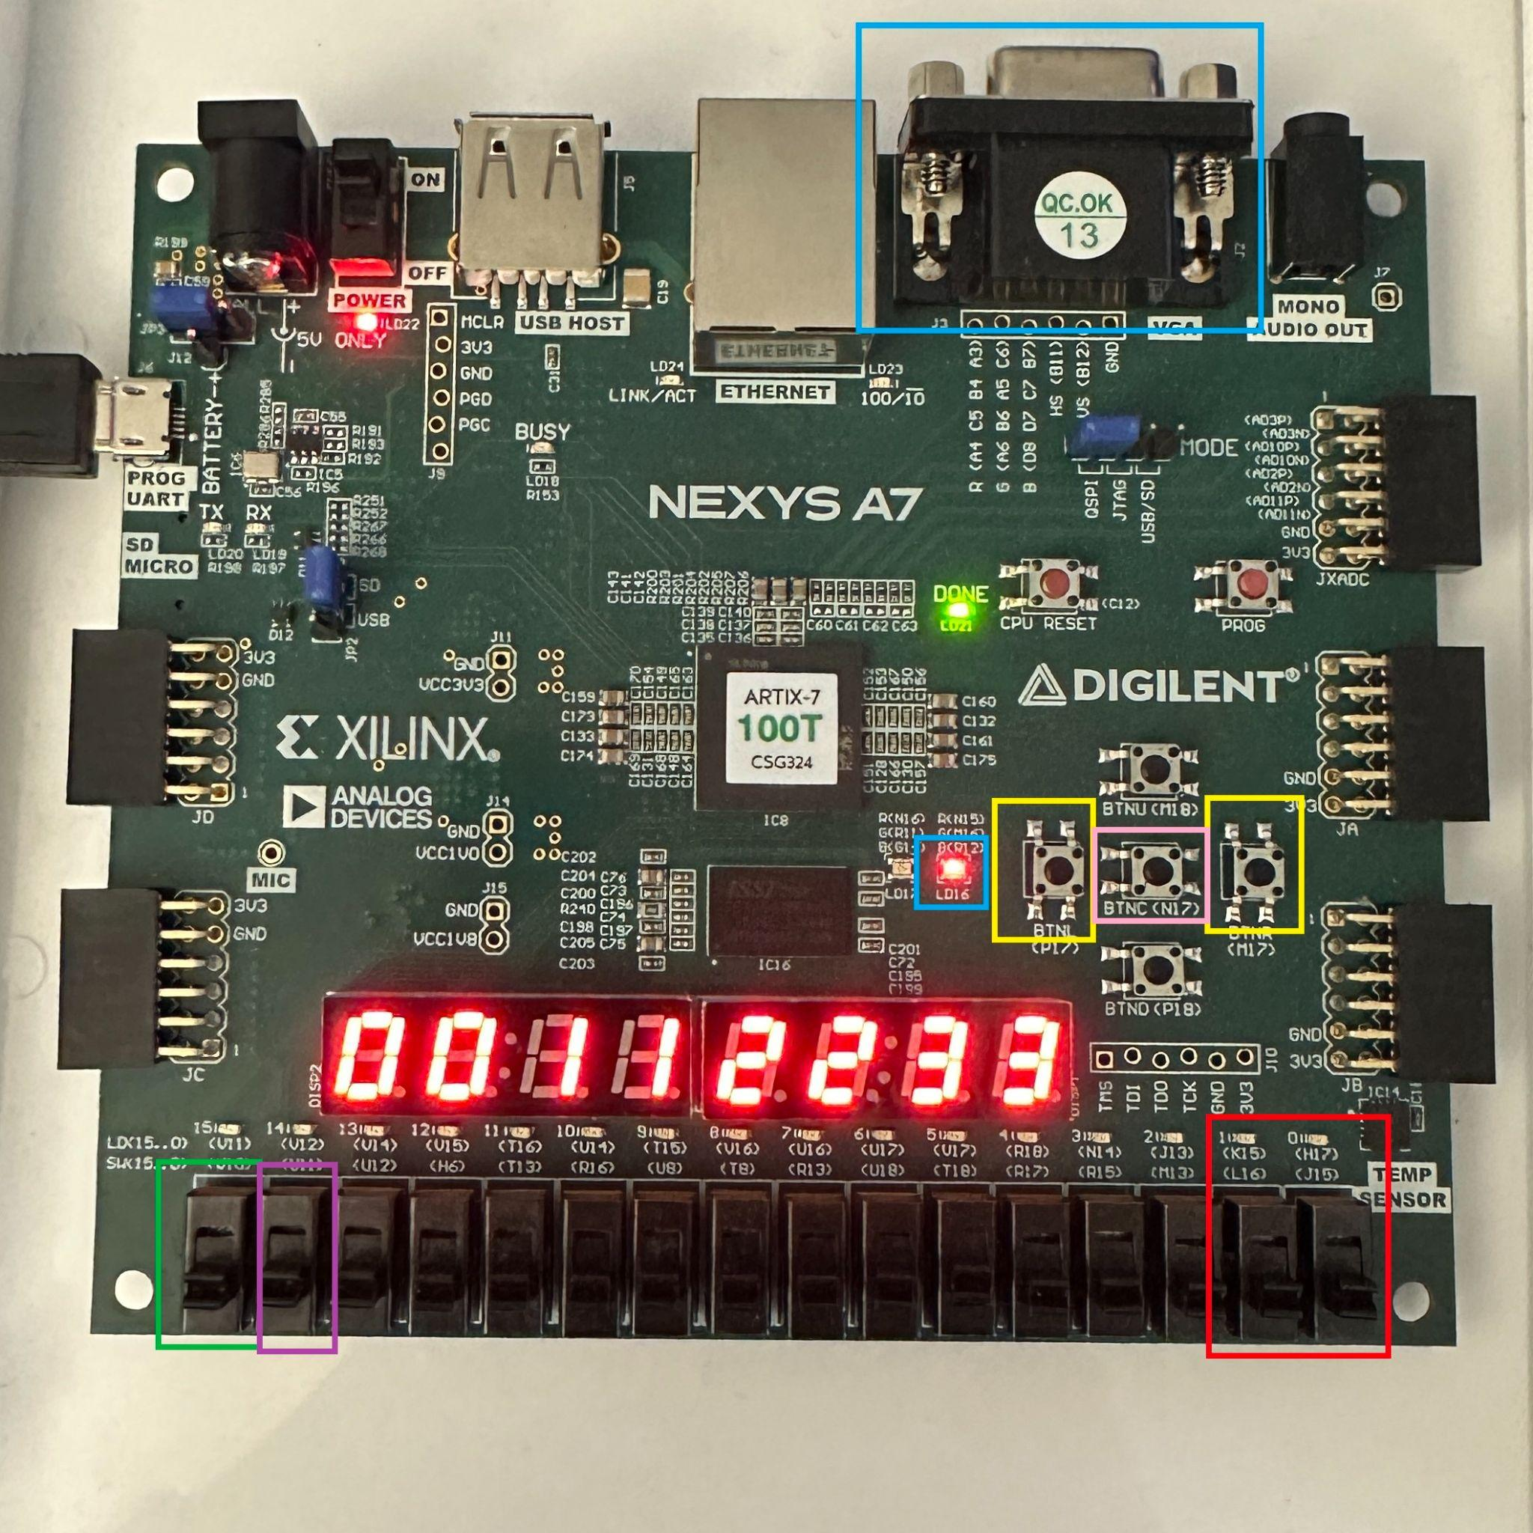
Board Layout
Blue: Encryption status indicators
Green: Select displaying data or key
Purple: Toggle 7-seg display autoscroll
Yellow: Move 7-seg display data left or right by 1 character
Red: Selected operation + indicator
Pink: Perform selected operation

Slide 4
Modules
clk_gen.v
Provides different clock frequencies using the main FPGA clock for different modules to operate at to ensure synchronization and proper control
ssd_driver.v
Used to driver the functionality of the seven segment displays, will display data such as the encryption or decryption status
Displaymanager.v
Controls which segment of the seven segment display is active

Slide 5
Modules
shiftrows.v and inverseshiftrows.v
Implements the Shift Rows function and its inverse function from the AES standard
Used to rotate the bytes in each row of the state matrix except the first, with the inverse rotating the bytes in the opposite direction as the original.
mix_columns.v and inversemix_columns.v
Mixes the columns of the state matrix using a mix of finite field multiplication and XOR, with the inverse reversing this process

Slide 6
Modules
sbox.v and inversesbox.v
Implements the substitution box (S-Box) used in AES, providing a non-linear substitution step where bytes are replaced based on a fix table, inverse reverses this function
addroundkey.v
Combines each byte of the state with a byte of the round key using bitwise XOR
bsnbit.v
Operates as a barrel shifter, used for the functionality of transformations in both shiftrows.v and inverseshiftrows.v

Slide 7
Modules
key_expander.v
Responsible for generating multiple keys for different rounds of the encryption/decryption process.
In the case of AES-128, 44 words are generated
cipher.v and inverse_cipher.v
Combines previous modules in the order specified by the AES standard in order to achieve the desired encryption and decryption of data
debounce.v
Used to ensure reliable functionality of the button used to initiate encryption and decryption

Slide 8
Modules
horizontal_counter.v and vertical_counter.v
Generates the horizontal and vertical sync signals for the VGA output
Controls the horizontal and vertical timing for displaying images via the VGA output

Slide 9
Top Module
top.v
Acts as the top-level module integrating all components of the AES encryption project
Takes care of managing the overall functionality, including taking user inputs, handling the encryption and decryption of entered data, as well as displaying this data on the output displays via the seven segment displays as well as the VGA output

